Slide 1




Hyderabad
Microservices Made Easier with ServiceMesh
Kusuma Seshavarapu, JDA Software
@skusumakumari

Slide 2
We are Living in a Digital Age
Image courtesy http://teazl.com/wp-content/uploads/2015/08/human-interaction.jpg

Slide 3

Changing Customer Demands
Always on, Available from Anywhere, Anytime
Reduced TCO
Self-Service
Lots of New Features all the time
Responsive
Personalized Experience

Slide 4








Slide 5
To Survive & Thrive Businesses need:
SPEED
AGILITY
ROBUSTNESS
and DO IT ALL at SCALE

Slide 6
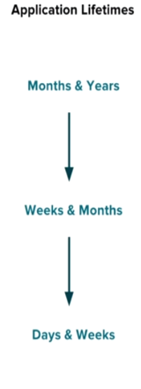
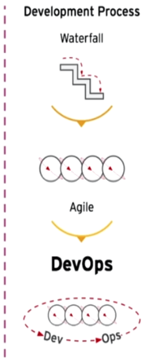
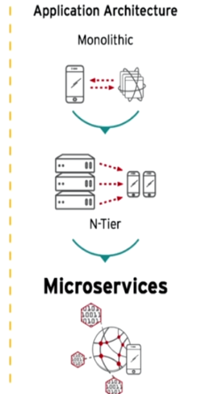
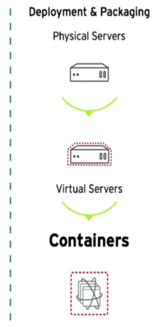
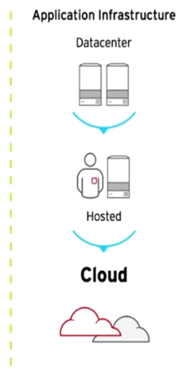
Changing IT trends in the industry
Image Courtesy: RedHat

Slide 7
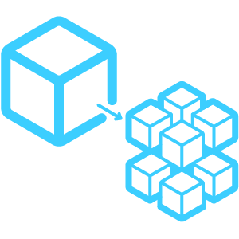
Roadmap to Digital Transformation
Remove Hardware Dependencies
Adopt Containers & CI/CD
Move to Microservices
Digital Transformation

Slide 8
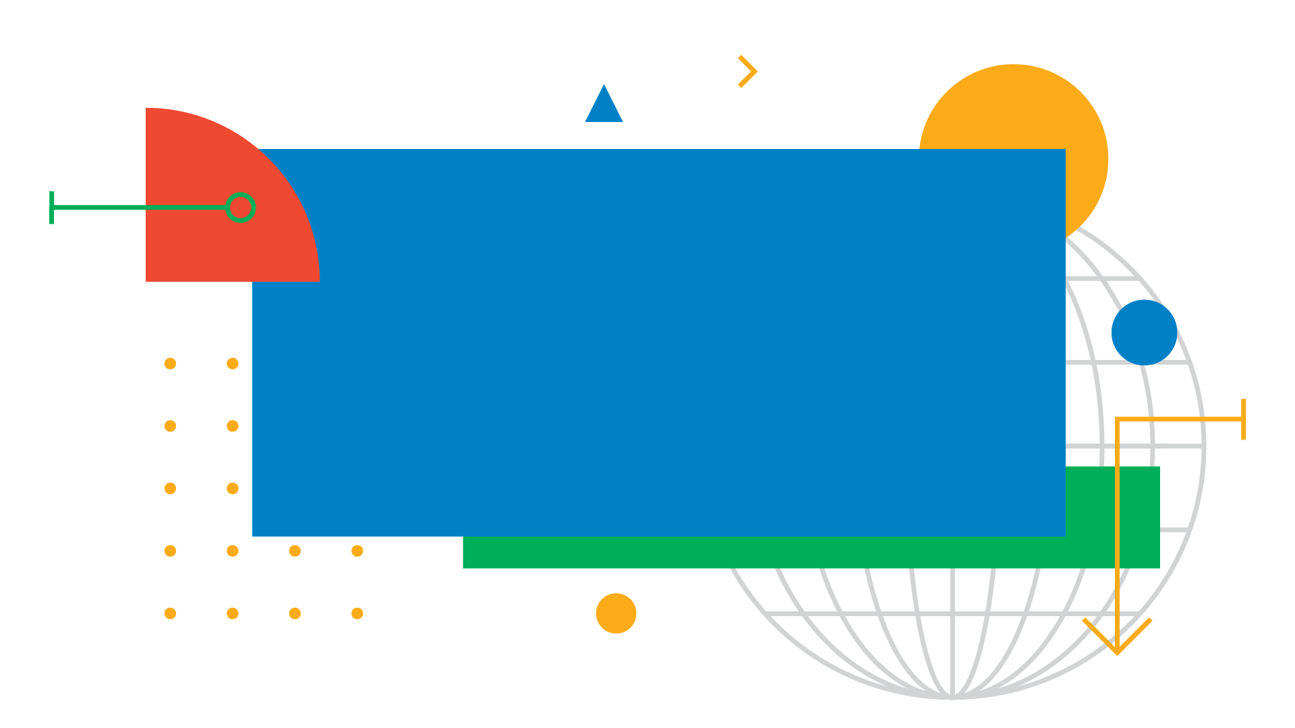
Microsevices Architecture
“service-oriented architecture
composed of
loosely coupled elements
that have
bounded contexts “
”
Adrian Cockcroft
(former Cloud Architect at Netflix)

Slide 9
Components of Microservices Architecture
Application
Components
Business Logic
Orchestration
Integration
Data Mgmt
A
Operational Components
Discovery
Config
Routing
Monitoring
Tracing
Security
B
Deployment
Components
Load Balancing
Execution Environment
C

Slide 10

Advantages of Microservices
Loose Coupling – Developed, Deployed & Scaled independently
Technology Diversity -Right tool for the right problem
Improved Reliability– Fault tolerance
High Scalability – Scale based on real-world bottlenecks
Continuous Delivery - Faster and simpler deployments and rollbacks
Full Stack Autonomous Teams - Speed & Agility

Slide 11
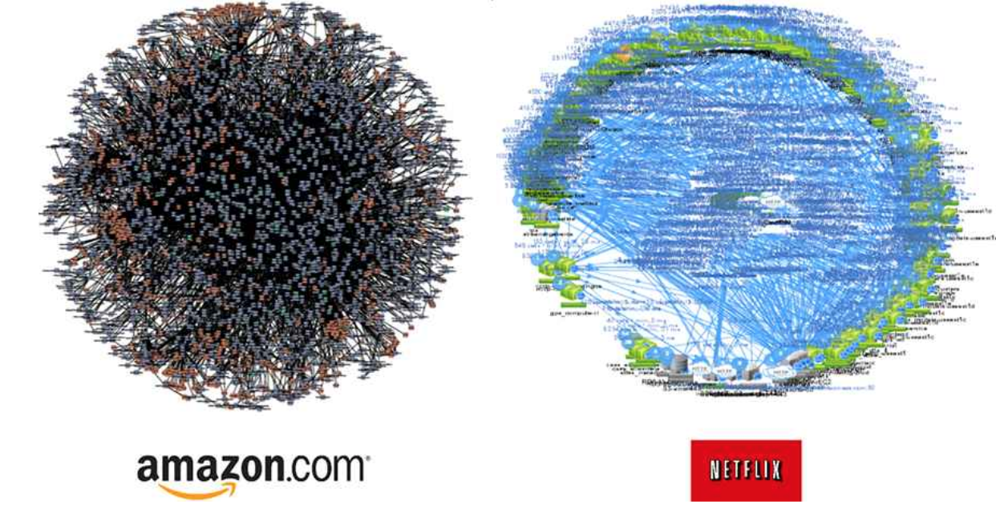
“Most complex challenge in realizing microservices is not building the services themselves, but how to establish reliable and observable communication between services”

Slide 12
Complexities of Microservices
Application Specific
Service Orchestration
Integration with other systems
Data Management
A
Service Discovery
Timeouts/Retries
Load Balancing/ Rate Limiting
Circuit Breaking
Application Reliability
B
Version/Request Specific Routing
A/B Rollout, Canary Releases
Dark Launches
Fault Injection
Application Deployment
C
Application Observability
Health Checks
Stats, Metrics
Logging
Distributed Tracing
Security
D

Slide 13
Service Mesh
“A service mesh is a dedicated infrastructure layer for handling service-to-service communication in a transparent and language agnostic way“
It decouples development and operations for services

Slide 14
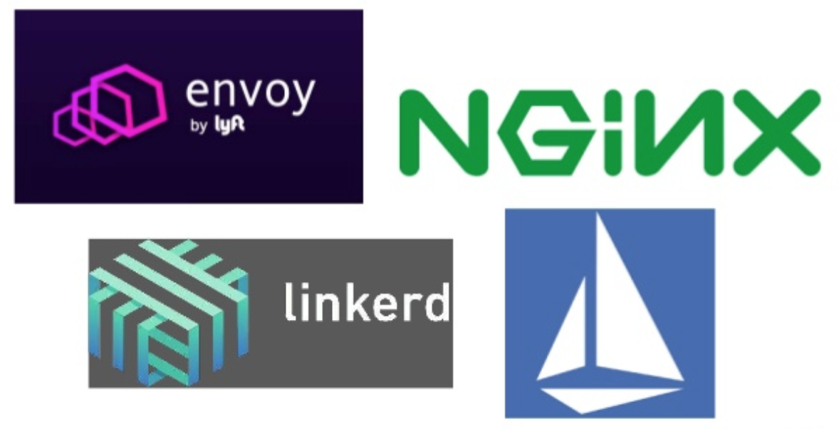
Service Mesh Implementations
Istio

Slide 15
Components of Service Mesh(Istio Example)
Control Plane
Configure Service Proxies
Controls Data Plane
A
Data Plane
Traffic Management
Health checking
Load balancing
Circuit breaking
Timeouts & Retries
Security
B
Image courtesy : Sameer Behra Dzone

Slide 16
Service Mesh Features
Resilience
Service Discovery
Timeouts/Retries
Circuit Breaking
A
Inter-service Communication
Load Balancing/ Rate Limiting
Routing
Fault injection
CI/CD release patterns
Traffic Management
B
Observability
Automatic Tracing
Metrics & Monitoring
Logging
C
Security
Authentication & Authorization
Policies - Service Access Control Lists - ACL
Secure transport with mTLS
D

Slide 17
Microservices without Service Mesh
Service A
Service B
Business Logic
Business Logic
You Develop & Manage Everything
You Develop & Manage Everything
Network Functions
Network Functions
Operational Components
Operational Components

Slide 18
Microservices with Service Mesh
Service Mesh
Control Plane
You Focus on Business Logic
Service Mesh
SideCar
Proxy
Service B
You Focus on Business Logic
Service A
Service Mesh
SideCar
Proxy
Business Logic
Business Logic
Network Call
Network Call
Delegate Networking & Operations to Service Mesh

Slide 20
Advantages of Service Mesh
Solves most of the problems in Microservices
Language Agnostic
Works well with polyglot microservices
Platform Agnostic
Works on Docker, Kubernetes, Mesos, Cloud, On-premise or any stand-alone machine
All Without Writing any Code

Slide 21
Disadvantages of Service Mesh
Adds extra hops: Each service call has to go through an extra hop(through service mesh sidecar proxy)
Service Meshes address a subset of problems: Microservice still needs to deal with
External traffic Mgmt.
Service Orchestration
DataManagement
Resource intensive if lot of instances are used
Immature: Service mesh technologies are relatively new and evolving.

Slide 22
How to Inject Service Mesh Proxy?
Manually inject using the CLI commands provided by the service mesh
$ kubectl apply-f \<(istioctl kube-inject-f samples/bookinfo/platform/kube/bookinfo.yaml)}
Automate the injection
Using kubernetes initializers
kubectl apply -f deployments/envoy-initializer.yaml
Use istio-enabled environment
kubectl label namespace default istio-injection=enabled
Service Mesh requires no changes to the application itself

Slide 23
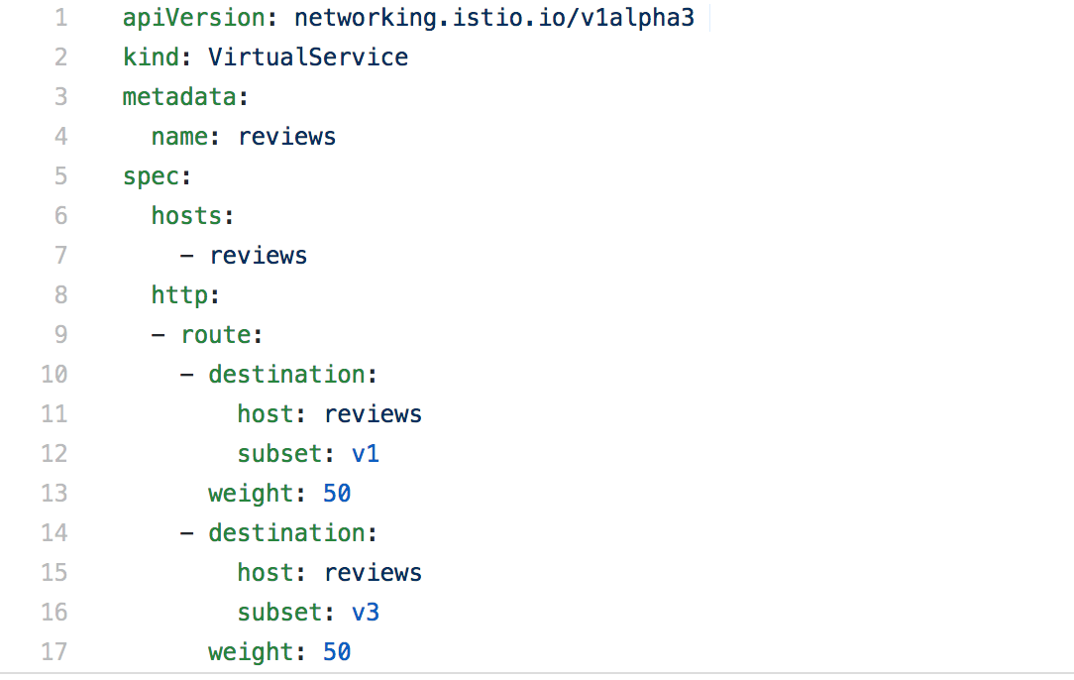
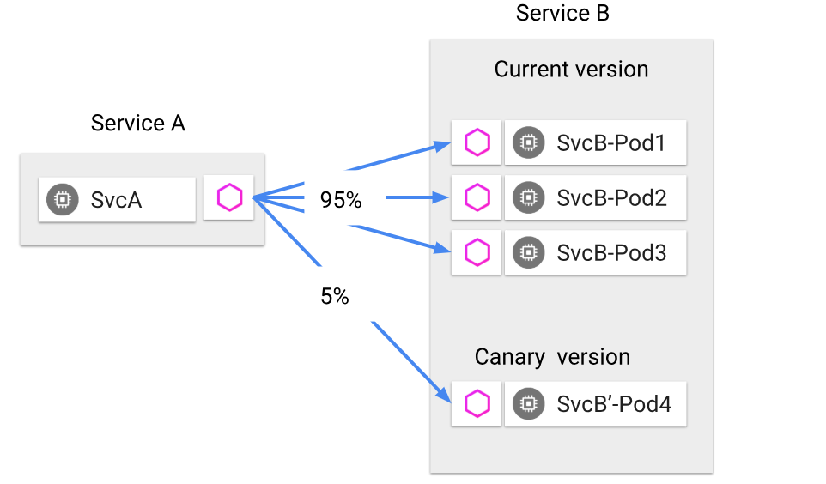
Sample of Traffic Splitting
95
5

Slide 24
When to Adopt a Service Mesh?
When your application is composed of 20+ services
When you want to decouple application logic from networking logic
When there is a deep hierarchy of service calls
When you have Polyglot services
When the shared library approach does not work/scale
When you want to simplify the microservices development

Slide 25
Hyderabad
Thank you!
Kusuma Seshavarapu, JDA Software
@skusumakumari

Slide 26
Hyderabad
Q&A

